Slide 1
ZOMATO Market Analysis:
An analytical approach
Sanchit Vashishtha
13-04-2024

Slide 2
ABOUT ZOMATO
Platform to search and explore new restaurants for dine-in and delivery, and give update to the wider audience about the experience through online reviews, posts, and photos upload.

Slide 3
PROBLEM STATEMENT
To come up with strategies/suggestions about opening newer restaurants as a consultant data analyst hired by zomato for expansion and opening of new restaurants

Slide 4
Core offerings
Zomato:Food ordering and delivery platform where customers can search and discover local restaurants, order food, and have it delivered reliably and quickly
Blinkit: Quick commerce platform where customers can order everyday needs across thousands of products and have them delivered within minutes
Hyperpure: Hyperpure is a B2B platform supplying high quality food ingredients and other products

Slide 5
Zomato Marketplace data snapshot
Total number of countries: As per the raw data, Zomato currently has 9551 restaurants associated with it, present in 141 cities, operating in 15 countries as part of its marketplace
Operating a total 1825 types of cuisines in a mixed setting (more than one type of cuisine clubbed together)
Total
Data cleaning & pre-processing:
Addressing missing value fields in the cuisines data field to enhance data integrity
Whites spaces were trimmed for effective analysis
Currency values were converted into a common Indian currency to normalize different values
The data allows for an understanding of the Zomato’s current market penetration in different countries to chart plan the expansion of its restaurant affiliations
A dashboard was created to view the correlation between a certain aspects of the data

Slide 6
Methods Utilized
Data cleaning: Utilized TRIM, remove duplicates for increasing data efficacy
Deriving insights: Conditional formatting, VLOOKUPS were utilized for cross-referencing data and to highlight certain data
Analytics: Pivot tables and charts utilized to summarize and visualized data
Dashboard was created to create a represent the summary of the data

Slide 7
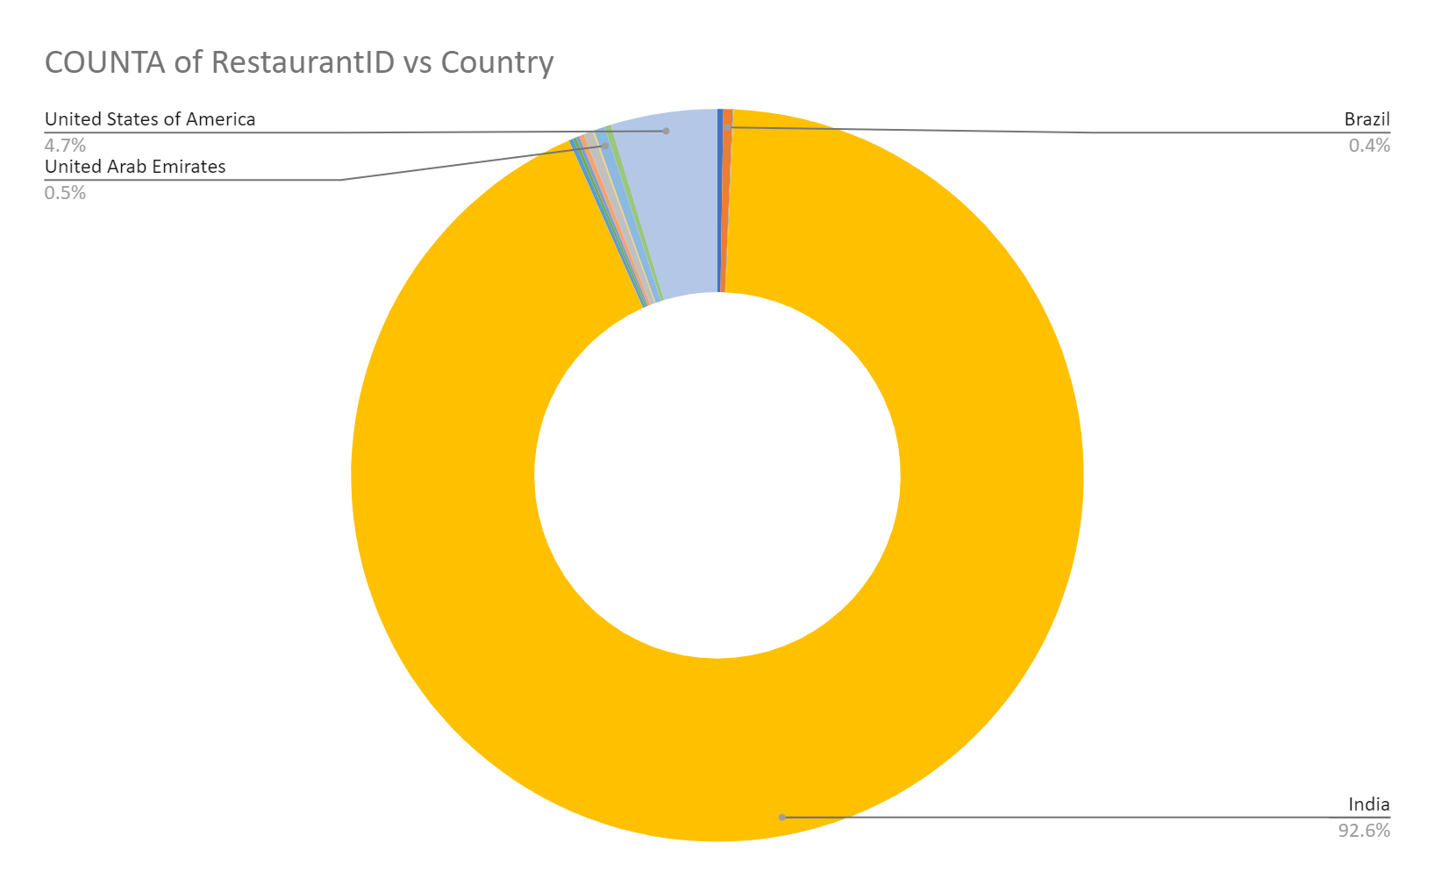
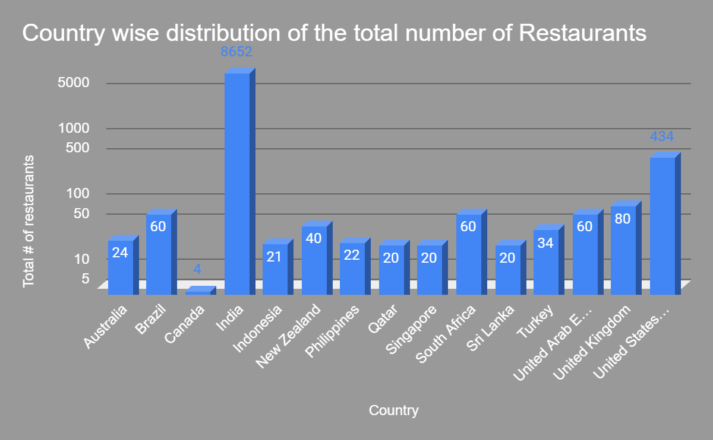
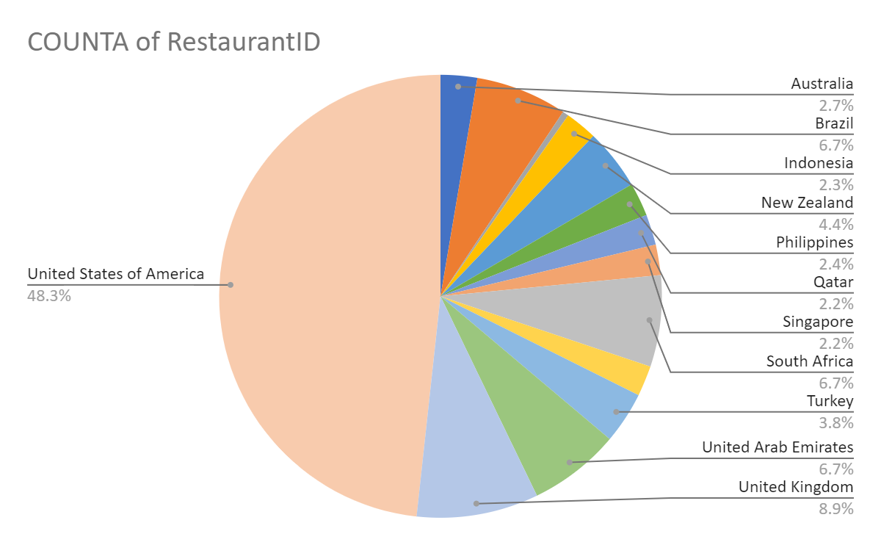
Analysis
India represents the most dominant market of Zomato affiliated restaurants with a market share close to 93%
USA is the biggest market outside of India (~50%; ~5% of total)

Slide 8
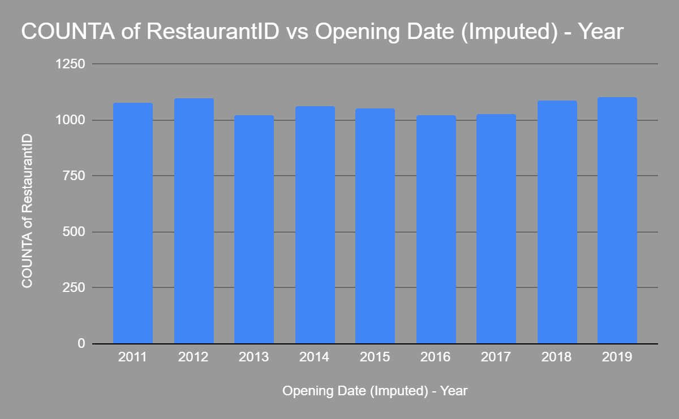
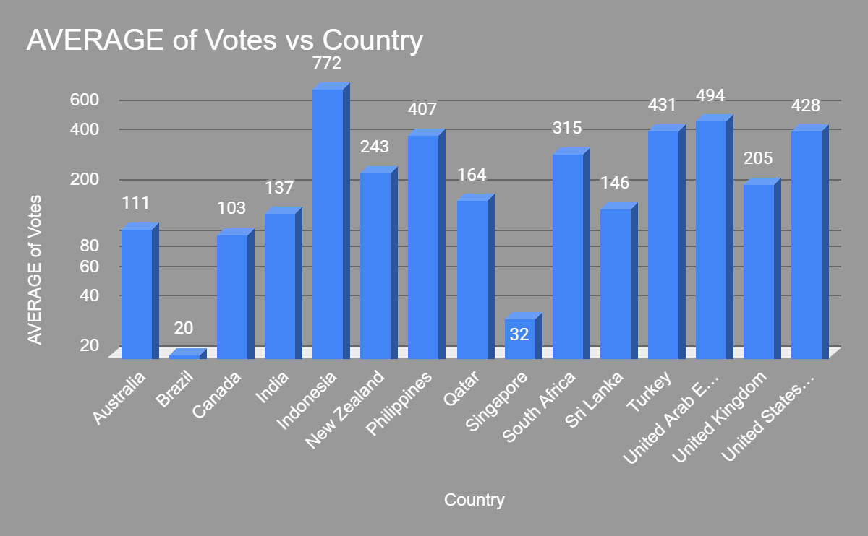
Informed customers
Booming Growth
Almost more than a 1000 restaurants are opened each year across different markets
Indonesian restaurants, on an average, receive highest number of average votes

Slide 9
Analysis
India represents the most dominant market of Zomato affiliated restaurants with a market share close to 93%
USA is the biggest market outside of India (~50%; ~5% of total)

Slide 10
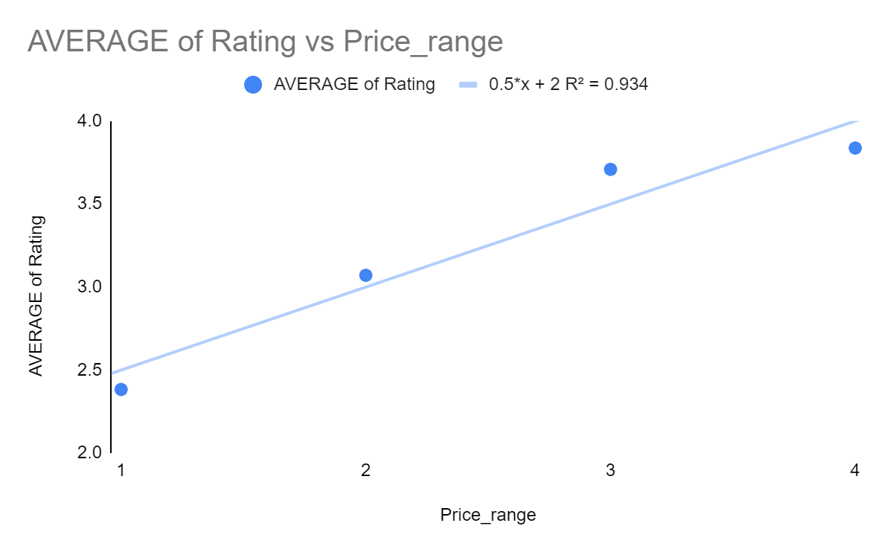
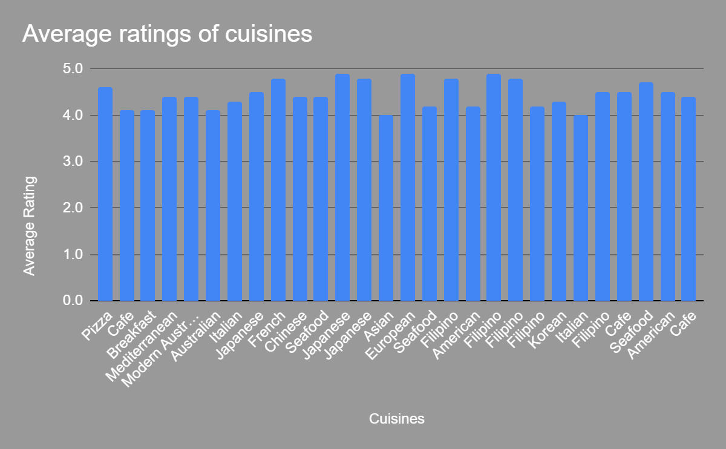
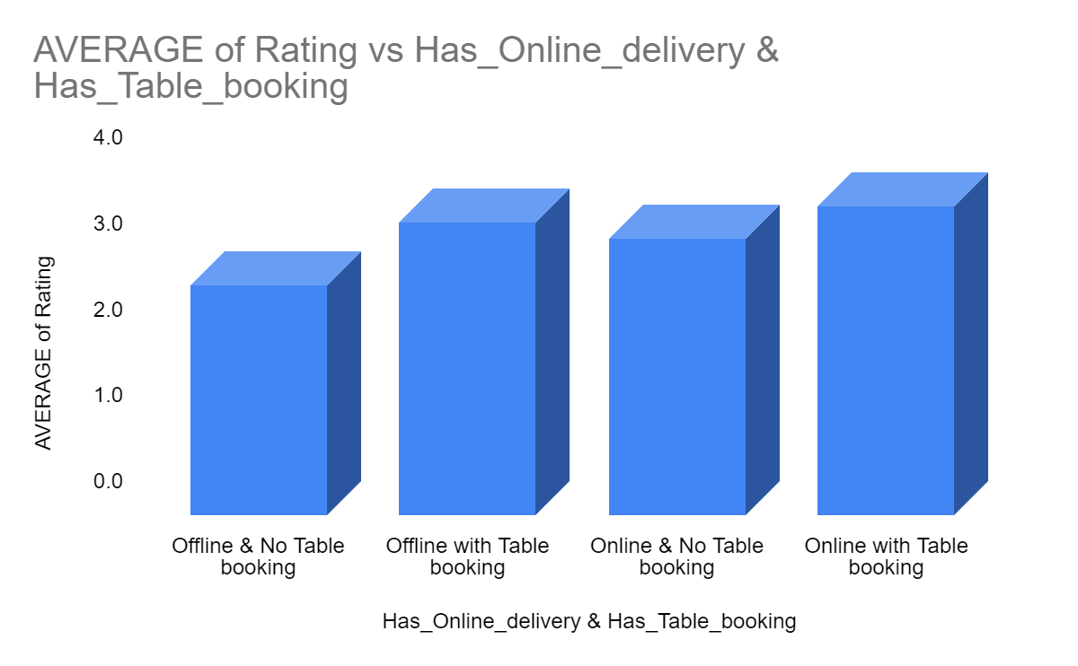
Analysis
Japanese, European are amongst the most popular standalone cuisines
Average ratings generally tend to increase with an option of table booking and online delivery
Ratings are generally directly proportional to the price range across the board

Slide 11
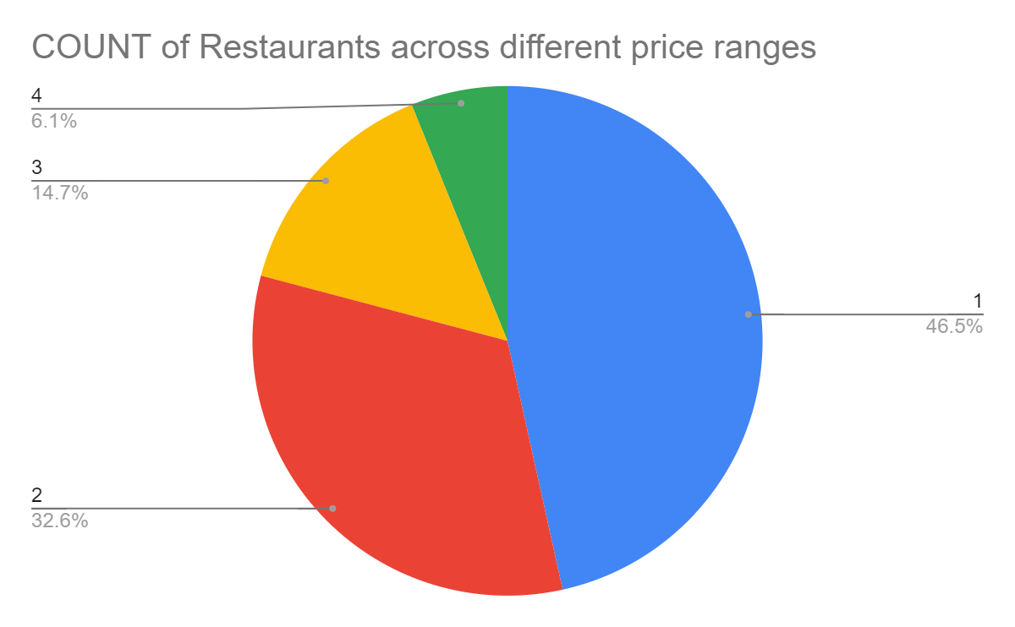
Analysis
Japanese, European & seafood are amongst the most popular standalone cuisines
Average ratings generally tend to increase with an option of table booking and online delivery
Ratings are generally directly proportional to the price range across the board
However, most restaurants are in the lowest price band

Slide 12
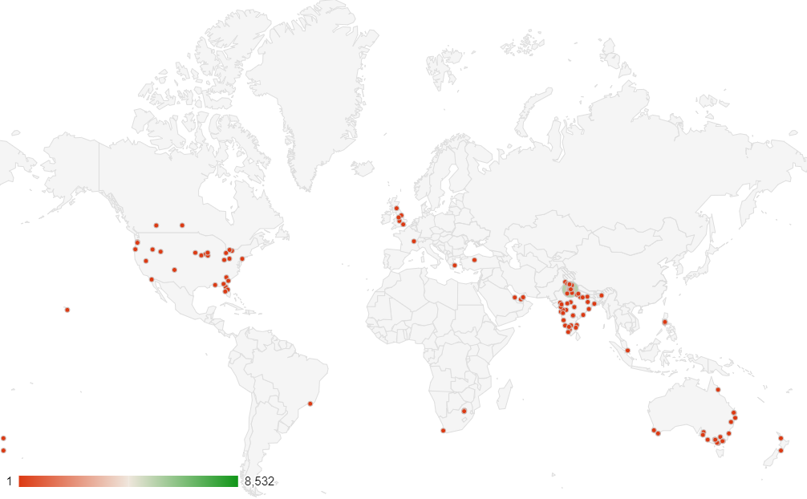
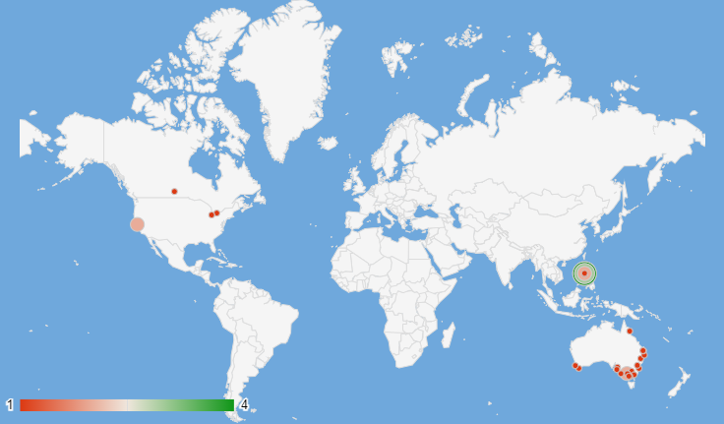
Newer markets
Cities having restaurant count of less than 10 and an average restaurant rating of 4 are considered for expansion into newer markets with lesser competition
Australia, Canada and the Philippines represent the least clustered market with fewer restaurants in all their cities (<10) per city
Less clustering leads to lesser competition
Canada has no restaurants in any of its ten most populous cities.
Could lead to more market opportunities
A few other cities (one each in the Philippines & in Indonesia) also fit into the criteria for lesser competition - table in next slide

Slide 13
Country | City | Has_Table_booking | Has_Online_delivery | COUNTA of RestaurantID | AVERAGE of Rating | AVERAGE of Avg. Cost for two_Currency (in Rs.)
Australia | Armidale | No | No | 1 | 3.5 | 1654.2
Australia | Balingup | No | No | 1 | 3.2 | 1654.2
Australia | Dicky Beach | No | No | 1 | 3.6 | 578.97
Australia | Flaxton | No | No | 1 | 3.5 | 2481.3
Australia | Forrest | No | No | 1 | 3.7 | 1654.2
Australia | Hepburn Springs | No | No | 2 | 3.8 | 1116.585
Australia | Inverloch | No | No | 1 | 3.7 | 578.97
Australia | Lakes Entrance | No | No | 1 | 3.8 | 578.97
Australia | Lorn | No | No | 1 | 3.6 | 1654.2
Australia | Macedon | No | No | 1 | 3.5 | 1654.2
Australia | Mayfield | No | No | 1 | 2.9 | 1654.2
Australia | Middleton Beach | No | No | 1 | 3.8 | 2481.3
Australia | Montville | No | No | 1 | 2.4 | 2481.3
Australia | Paynesville | No | No | 1 | 2.6 | 9925.2
Australia | Penola | No | No | 1 | 3.4 | 1654.2
Australia | Phillip Island | No | No | 1 | 3.7 | 1654.2
Australia | Victor Harbor | No | No | 1 | 3.6 | 1654.2
Canada | Chatham-Kent | No | No | 1 | 3.7 | 2067.75
Canada | Consort | No | No | 1 | 3.0 | 2067.75
Canada | Yorkton | No | No | 1 | 3.3 | 2067.75
Indonesia | Bogor | No | No | 2 | 3.9 | 848
Philippines | Santa Rosa | No | No | 2 | 3.8 | 5032.5

Slide 14
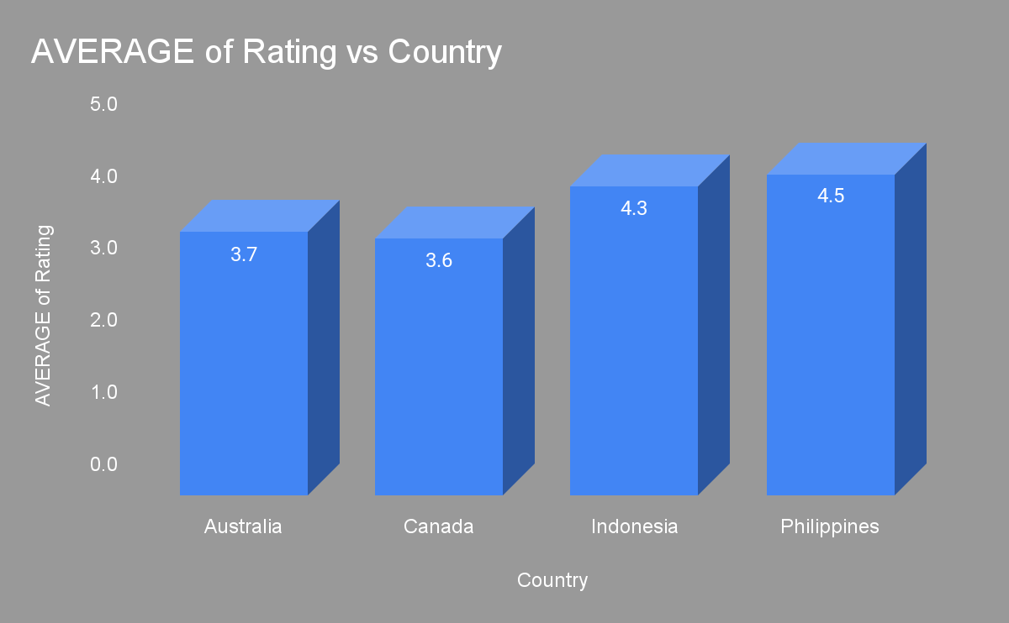
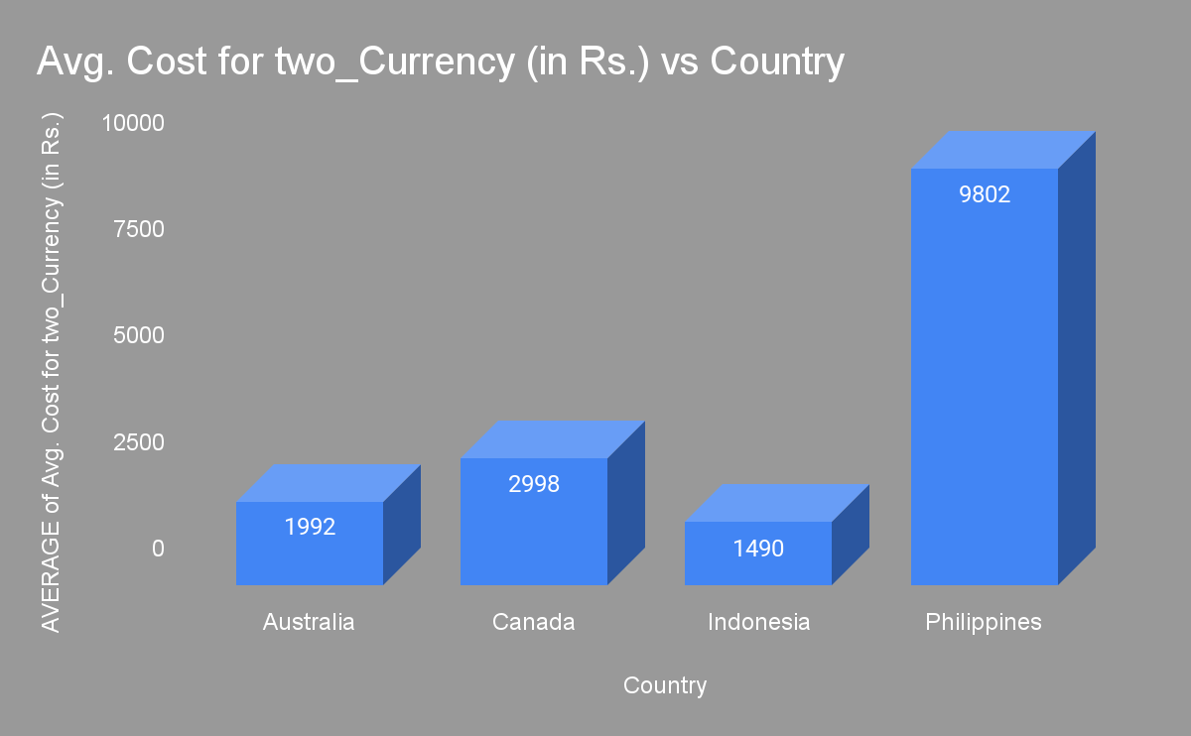
Higher cost = Higher ratings
Of the suggested countries, restaurants in the philippines have the highest average dining cost for two, but also enjoys highest average ratings

Slide 15
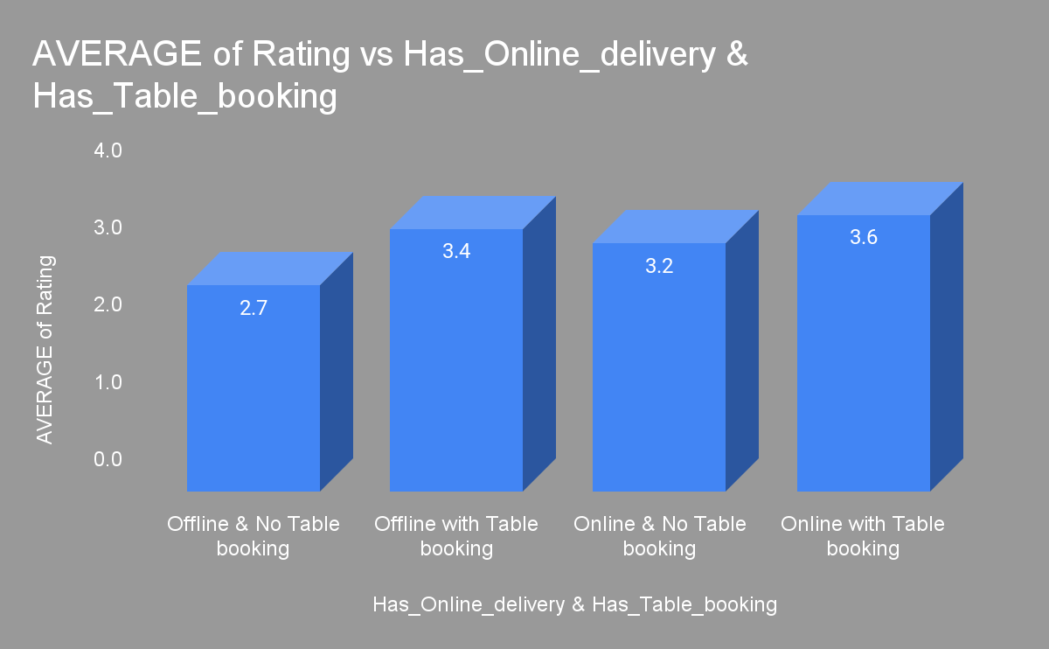
Recommendations - Moving Online
Country | City | Has_Table_booking | Has_Online_delivery
Australia | Armidale | No | No
Australia | Balingup | No | No
Australia | Dicky Beach | No | No
Australia | Flaxton | No | No
Australia | Forrest | No | No
Australia | Hepburn Springs | No | No
Australia | Inverloch | No | No
Australia | Lakes Entrance | No | No
Australia | Lorn | No | No
Australia | Macedon | No | No
Australia | Mayfield | No | No
Australia | Middleton Beach | No | No
Australia | Montville | No | No
Australia | Paynesville | No | No
Australia | Penola | No | No
Australia | Phillip Island | No | No
Australia | Victor Harbor | No | No
Canada | Chatham-Kent | No | No
Canada | Consort | No | No
Canada | Yorkton | No | No
Indonesia | Bogor | No | No
Philippines | Santa Rosa | No | No
Restaurants that provide advance table booking, combined with online delivery tend to be liked more by the customers
No restaurants in the recommended cities have either of the two options

Slide 16
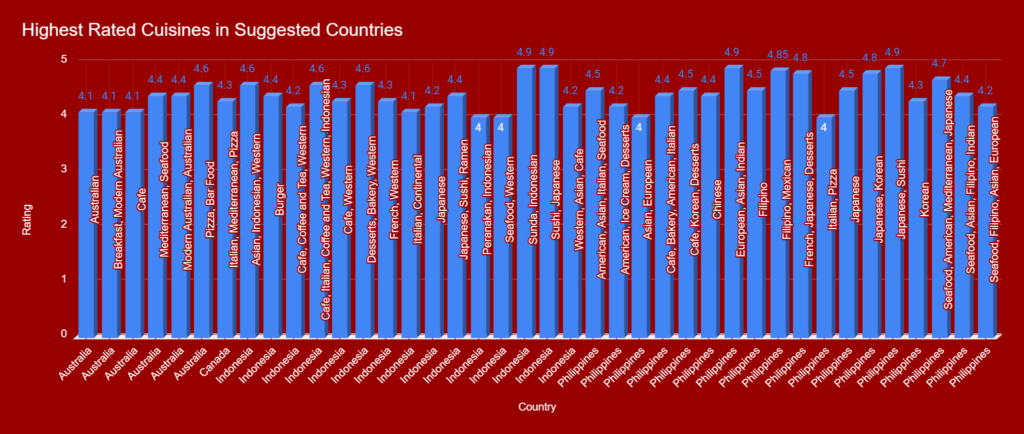
Recommendations - Cuisines
Ideal to open a multi-cuisine restaurant
Many cuisines have a rating of more than 4 in the recommended countries across the world

Slide 17
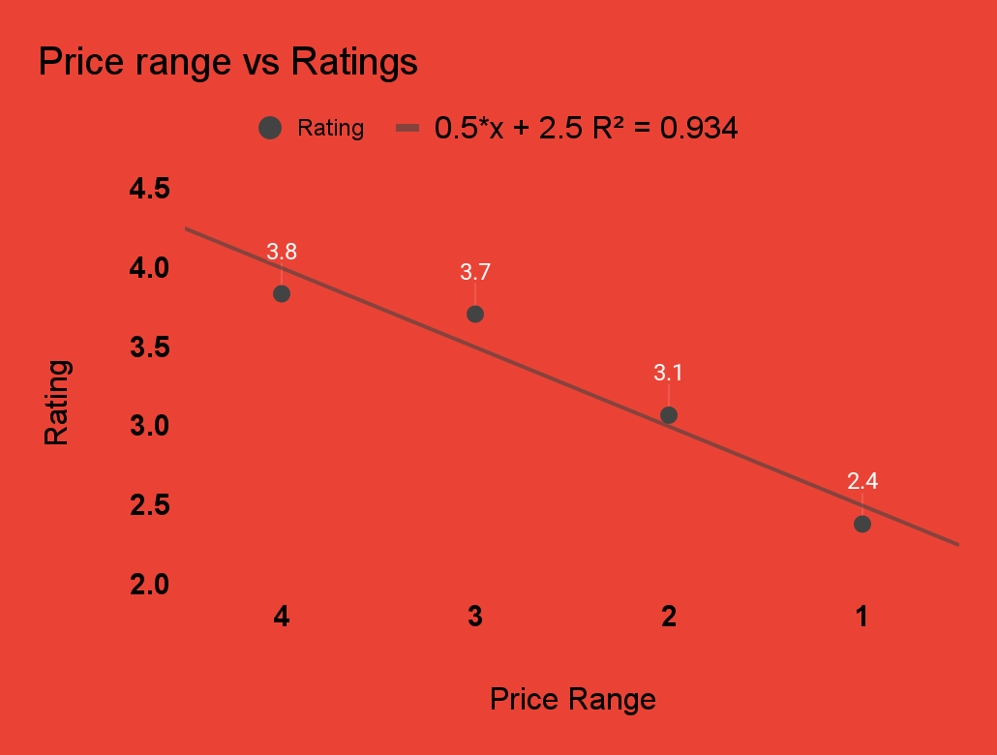
Affluent customers
Customers are willing to shell more money on the quality of food
Higher price range transcends into higher ratings

Slide 18
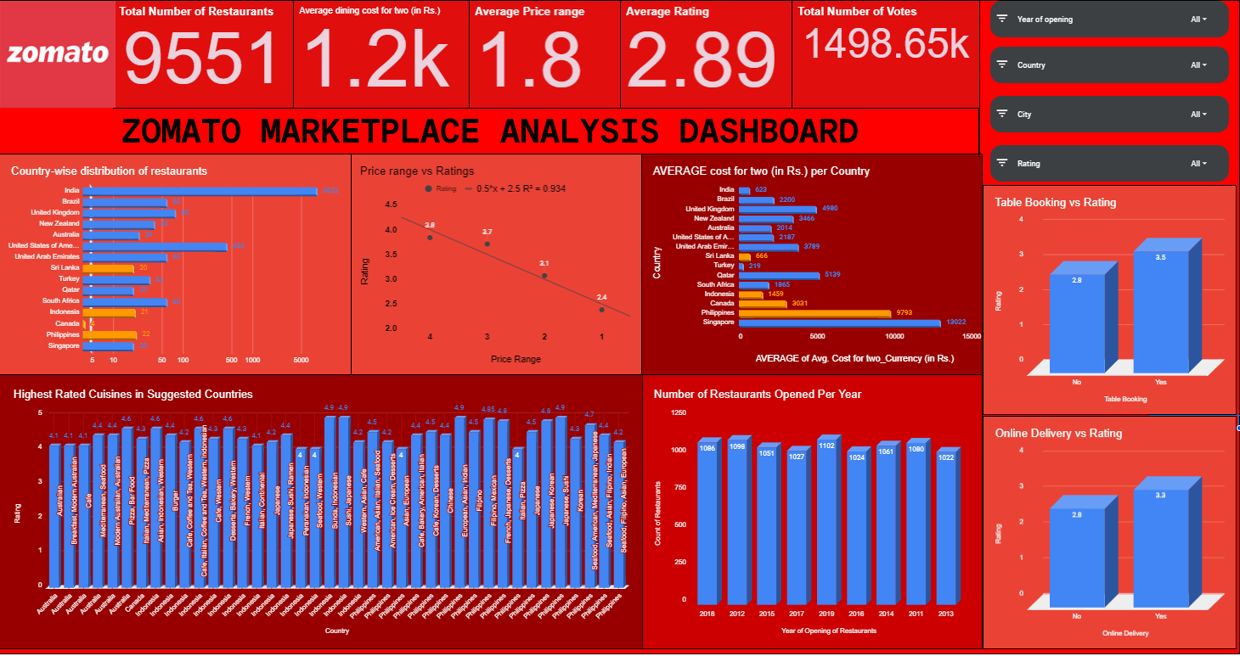

Slide 19
CONCLUSIONS
Zomato’s market share outside of India is very low (~7%), out of which USA occupies half of it
Canada, Australia and the Philippines are some of the most unclustered markets for zomato that may offer new opportunities for market penetration
Customers are willing to spend more money to have a high quality of food
No one cuisine could be identified that is most loved.
A multi-cuisines approach would suit well to penetrate a newer market
Online delivery and table booking generally transcends into a higher slighly rating

Slide 20
References
https://www.zomato.com/who-we-are
https://blog.zomato.com/switching-from-tidb-to-dynamodb
https://www.zomato.com/investor-relations

